Slide 1
Topic Modeling
Peitian Zhang
Renmin University of China
Currently @ MSRA Social Computing

Slide 2
Outline
Overview
Datasets
Metrics
Traditional Methods
Neural Methods
BERT-based Methods
Summary

Slide 3
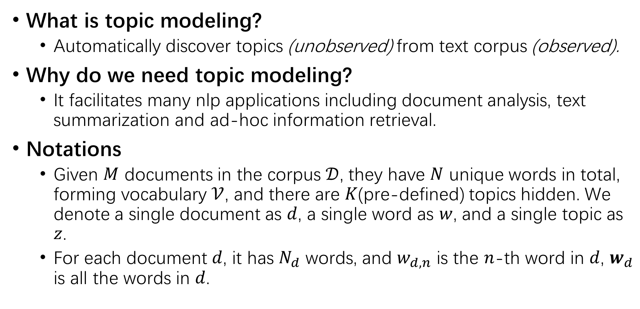
Overview
What is topic modeling?
Automatically discover topics (unobserved) from text corpus (observed).
Why do we need topic modeling?
It facilitates many nlp applications including document analysis, text summarization and ad-hoc information retrieval.
Notations
Given $M$ documents in the corpus $𝒟$, they have $N$ unique words in total, forming vocabulary $𝒱$, and there are $K$(pre-defined) topics hidden. We denote a single document as $d$, a single word as $w$, and a single topic as $z$.
For each document $d$, it has $N_{d}$ words, and $w_{d,n}$ is the $n$-th word in $d$, $w_{d}$ is all the words in $d$.

Slide 4
Datasets
20Newsgroups
A collection of approximately 20,000 annotated articles, partitioned evenly across 20 different topics.
NYTimes
A collection of 180000 news articles published between 1987 and 2007.
Different papers use different preprocessing methods to filter out some documents or words, resulting in different document/word number in total.

Slide 5
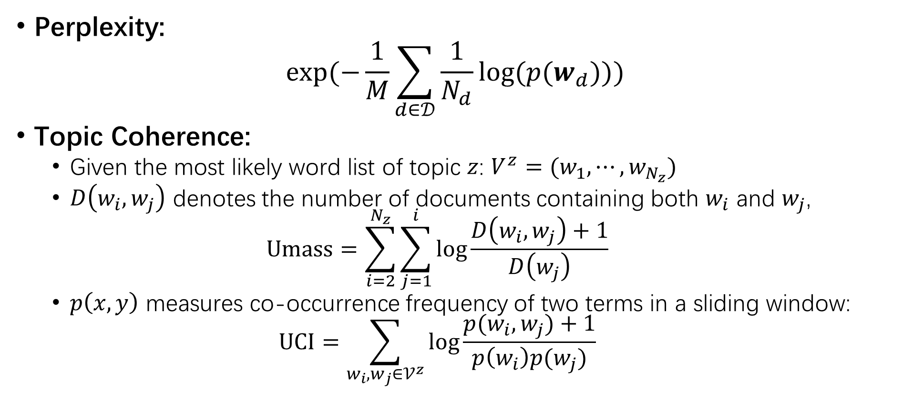
Metrics
Perplexity:
$$exp⁡(−\frac{1}{M}\sum_{d∈𝒟}{\frac{1}{N_{d}}log⁡(p(w_{d}))})$$
Topic Coherence:
Given the most likely word list of topic $z$: $V^{z}=(w_{1},⋯,w_{N_{z}})$
$D\left(w_{i},w_{j}\right)$ denotes the number of documents containing both $w_{i}$ and $w_{j}$,
$$Umass=\sum_{i=2}^{N_{z}}{\sum_{j=1}^{i}{\log{\frac{D\left(w_{i}, w_{j}\right)+1}{D\left(w_{j}\right)}}}}$$
$p\left(x,y\right)$ measures co-occurrence frequency of two terms in a sliding window:
$$UCI=\sum_{w_{i},w_{j}∈𝒱^{z}}{\log{\frac{p(w_{i},w_{j})+1}{p\left(w_{i}\right)p(w_{j})}}}$$

Slide 6
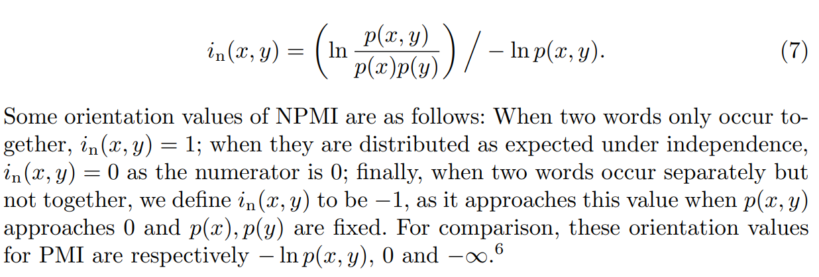
Metrics
Topic Coherence
Normalized Pointwise Mutual Information (Normalized UCI)

Slide 7
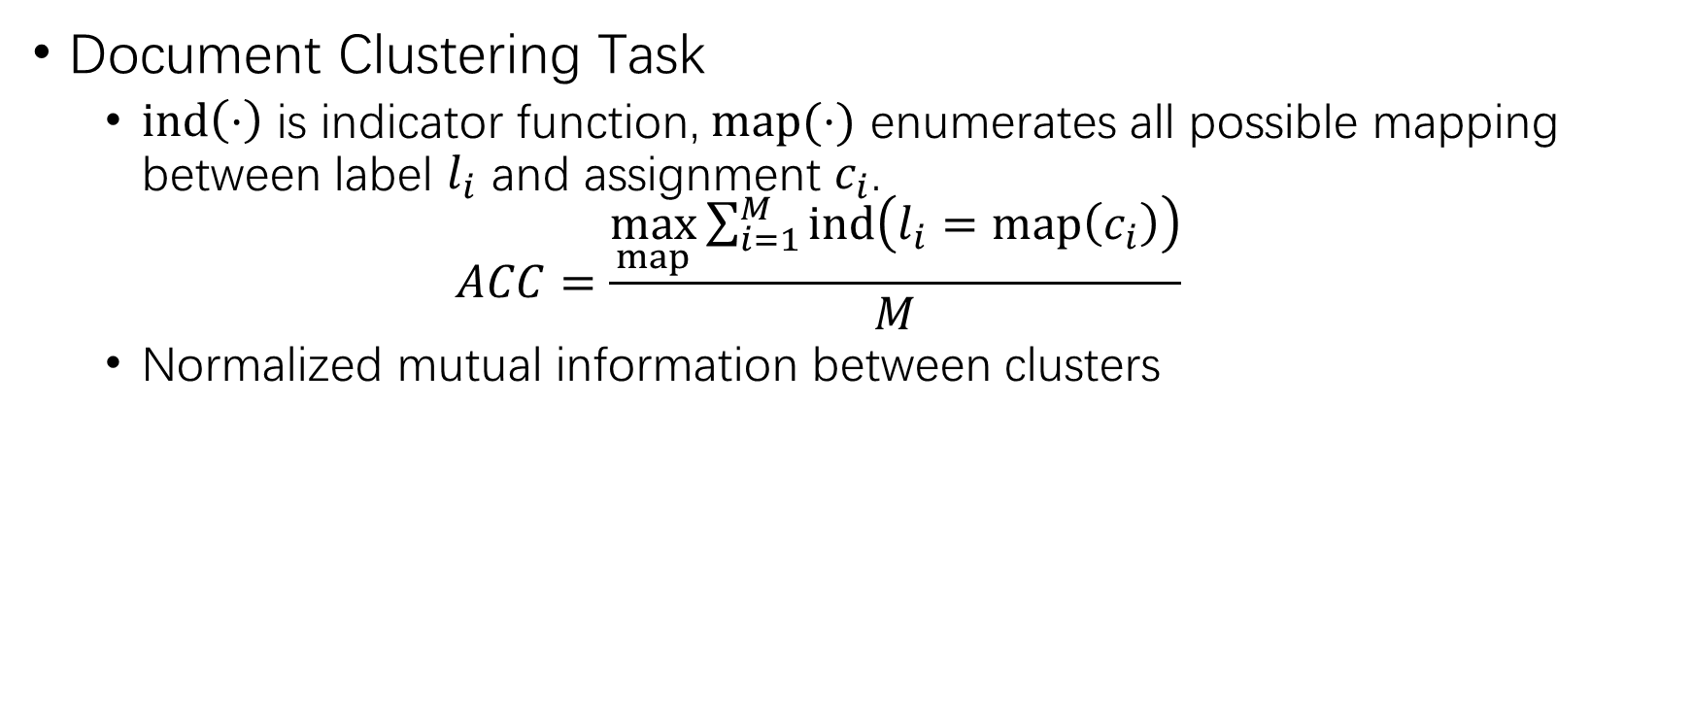
Metrics
Document Clustering Task
$ind\left(⋅\right)$ is indicator function, $map(⋅)$ enumerates all possible mapping between label $l_{i}$ and assignment $c_{i}$.
$$ACC=\frac{\max_{map}{\sum_{i=1}^{M}{ind\left(l_{i}=map\left(c_{i}\right)\right)}}}{M}$$
Normalized mutual information between clusters

Slide 8
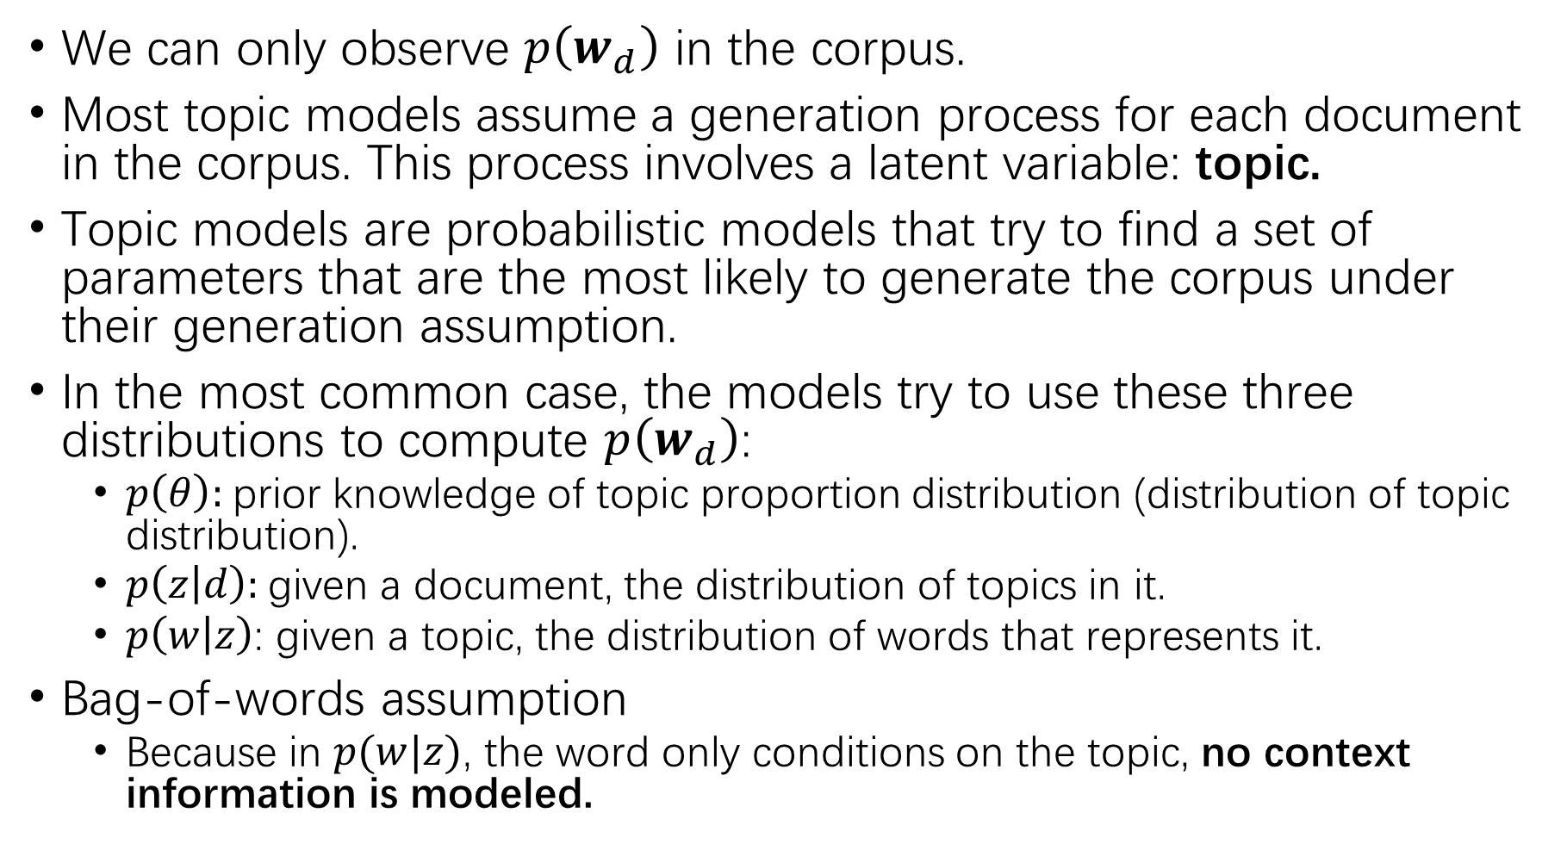
We can only observe $p\left(w_{d}\right)$ in the corpus.
Most topic models assume a generation process for each document in the corpus. This process involves a latent variable: topic.
Topic models are probabilistic models that try to find a set of parameters that are the most likely to generate the corpus under their generation assumption.
In the most common case, the models try to use these three distributions to compute $p\left(w_{d}\right)$:
$p\left(θ\right)$: prior knowledge of topic proportion distribution (distribution of topic distribution).
$p\left(z | d\right)$: given a document, the distribution of topics in it.
$p\left(w | z\right)$: given a topic, the distribution of words that represents it.
Bag-of-words assumption
Because in $p(w|z)$, the word only conditions on the topic, no context information is modeled.

Slide 9
Traditional Methods
Resort to analytic solutions;
Difficult math;

Slide 10
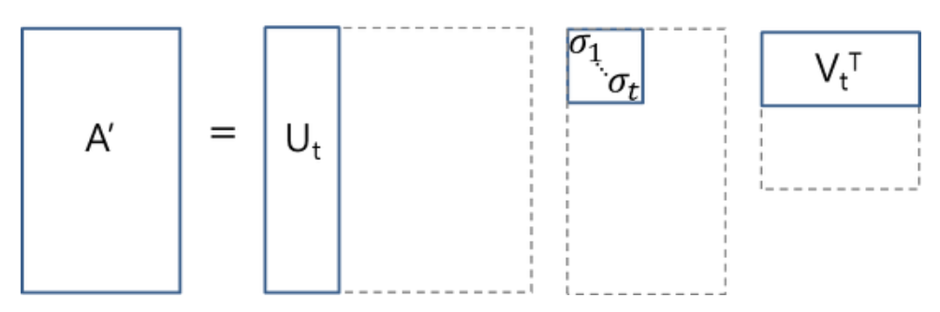
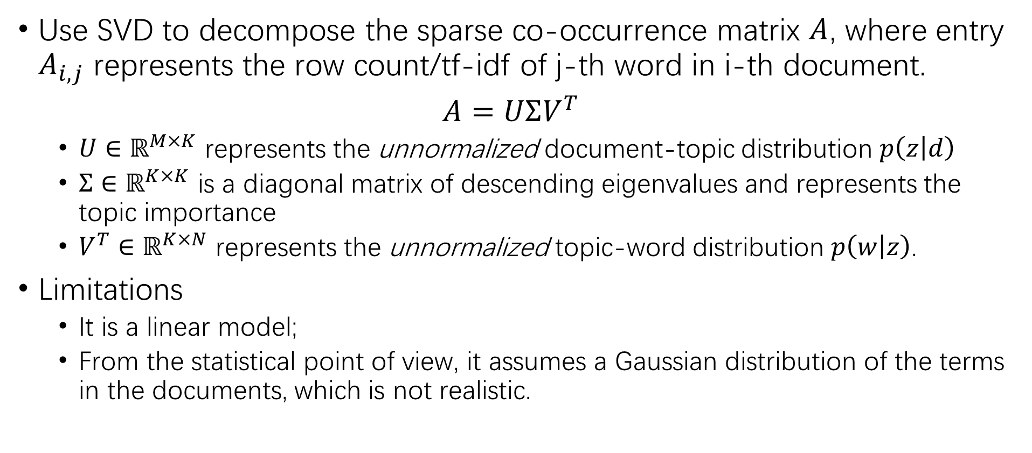
Latent Semantic Analysis
Use SVD to decompose the sparse co-occurrence matrix $A$, where entry $A_{i,j}$ represents the row count/tf-idf of j-th word in i-th document.
$A=UΣV^{T}$
$U∈ℝ^{M×K}$ represents the unnormalized document-topic distribution $p\left(z | d\right)$
$Σ∈ℝ^{K×K}$ is a diagonal matrix of descending eigenvalues and represents the topic importance
$V^{T}∈ℝ^{K×N}$ represents the unnormalized topic-word distribution $p\left(w | z\right)$.
Limitations
It is a linear model;
From the statistical point of view, it assumes a Gaussian distribution of the terms in the documents, which is not realistic.

Slide 11
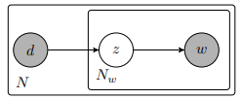
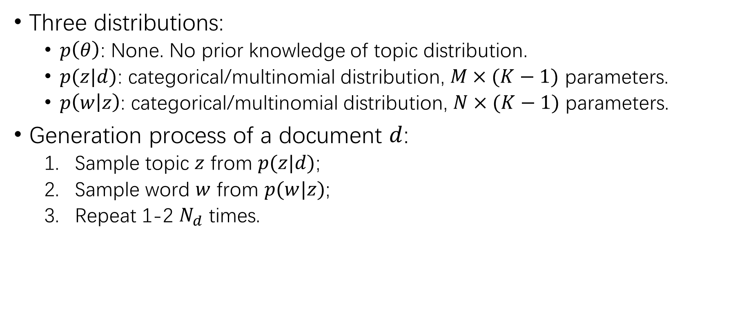
PLSA
Three distributions:
$p\left(θ\right)$: None. No prior knowledge of topic distribution.
$p(z|d)$: categorical/multinomial distribution, $M×(K−1)$ parameters.
$p\left(w | z\right)$: categorical/multinomial distribution, $N×(K−1)$ parameters.
Generation process of a document $d$:
Sample topic $z$ from $p(z|d)$;
Sample word $w$ from $p(w|z)$;
Repeat 1-2 $N_{d}$ times.

Slide 12
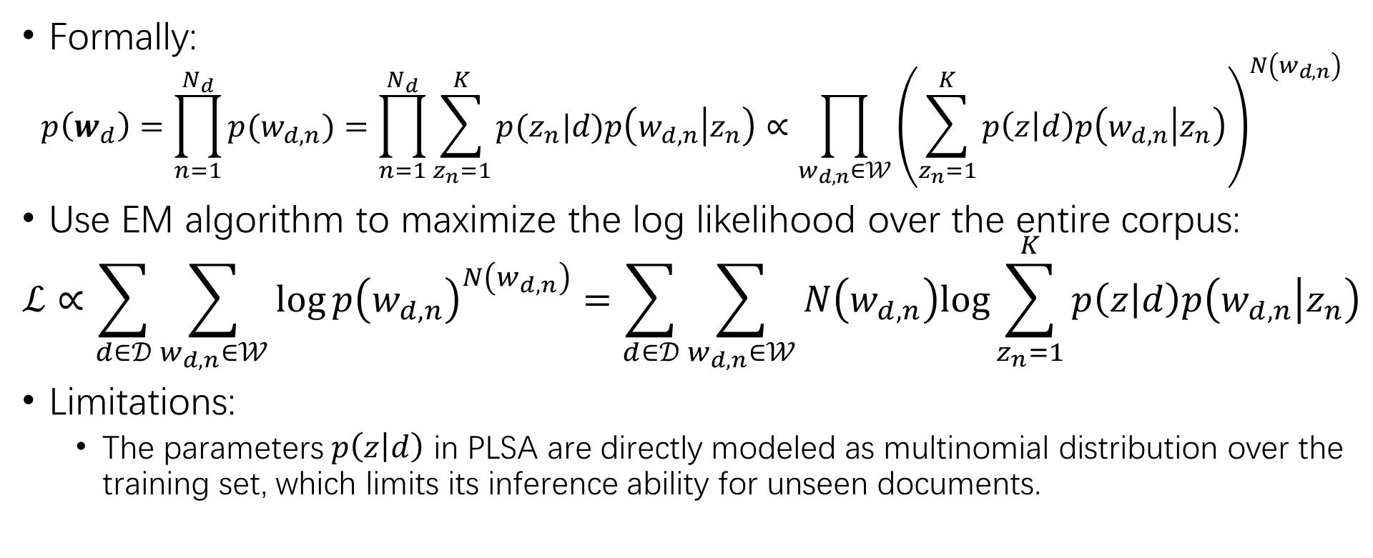
PLSA
Formally:
$$p\left(w_{d}\right)=\prod_{n=1}^{N_{d}}{p(w_{d,n})}=\prod_{n=1}^{N_{d}}{\sum_{z_{n}=1}^{K}{p(z_{n}|d)p\left(w_{d,n} | z_{n}\right)}}∝\prod_{w_{d,n}∈𝒲}{{\left(\sum_{z_{n}=1}^{K}{p\left(z | d\right)p\left(w_{d,n} | z_{n}\right)}\right)}^{N\left(w_{d,n}\right)}}$$
Use EM algorithm to maximize the log likelihood over the entire corpus:
$$ℒ∝\sum_{d∈𝒟}{\sum_{w_{d,n}∈𝒲}{\log{p{\left(w_{d,n}\right)}^{N\left(w_{d,n}\right)}}=\sum_{d∈𝒟}{\sum_{w_{d,n}∈𝒲}{N\left(w_{d,n}\right)log{\sum_{z_{n}=1}^{K}{p\left(z | d\right)p\left(w_{d,n} | z_{n}\right)}}}}}}$$
Limitations:
The parameters $p\left(z | d\right)$ in PLSA are directly modeled as multinomial distribution over the training set, which limits its inference ability for unseen documents.

Slide 13
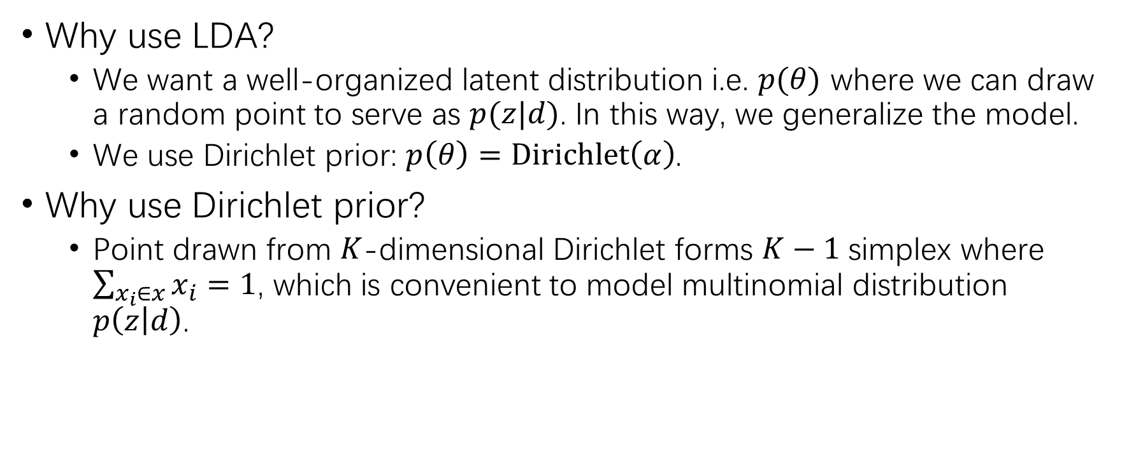
Latent Dirichlet Allocation
Why use LDA?
We want a well-organized latent distribution i.e. $p(θ)$ where we can draw a random point to serve as $p(z|d)$. In this way, we generalize the model.
We use Dirichlet prior: $p\left(θ\right)=Dirichlet\left(α\right)$.
Why use Dirichlet prior?
Point drawn from $K$-dimensional Dirichlet forms $K−1$ simplex where $\sum_{x_{i}∈x}{x_{i}}=1$, which is convenient to model multinomial distribution $p\left(z | d\right)$.

Slide 14
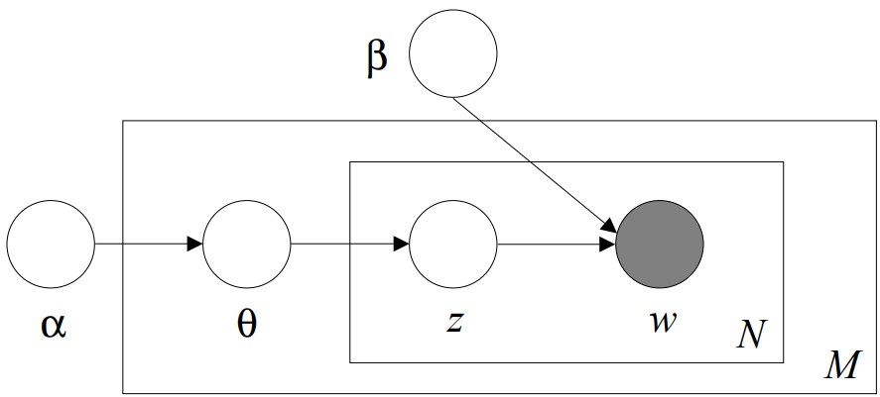
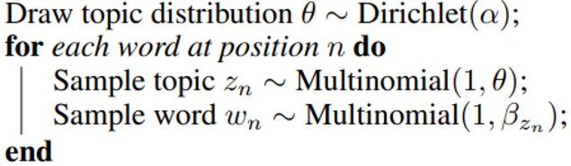
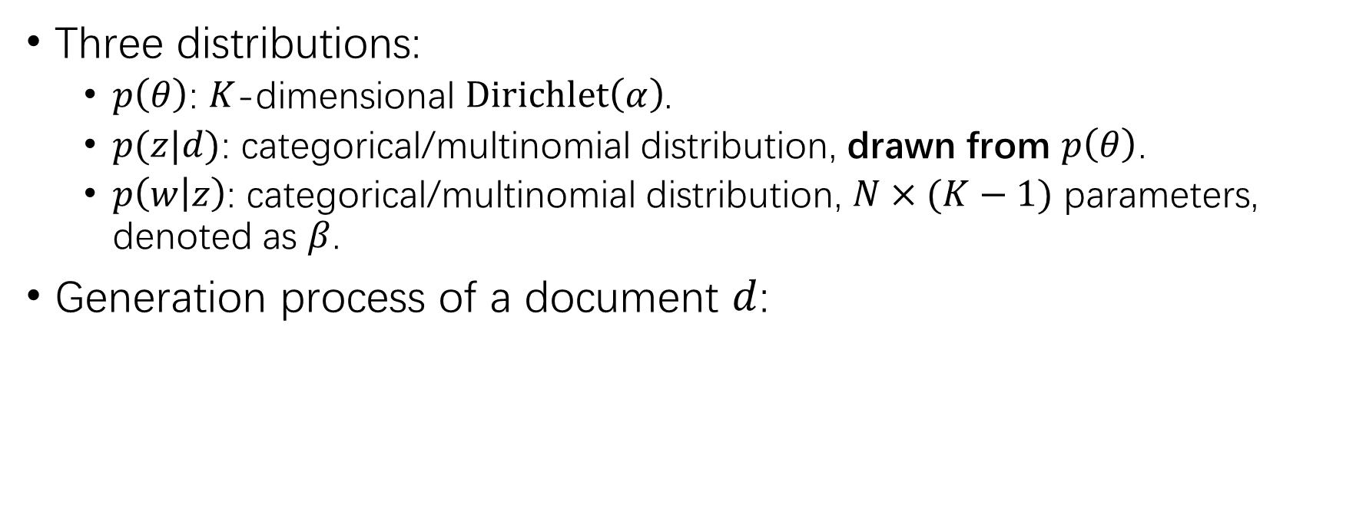
Latent Dirichlet Allocation
Three distributions:
$p\left(θ\right)$: $K$-dimensional $Dirichlet\left(α\right)$.
$p(z|d)$: categorical/multinomial distribution, drawn from $p\left(θ\right)$.
$p\left(w | z\right)$: categorical/multinomial distribution, $N×(K−1)$ parameters, denoted as $β$.
Generation process of a document $d$:

Slide 15
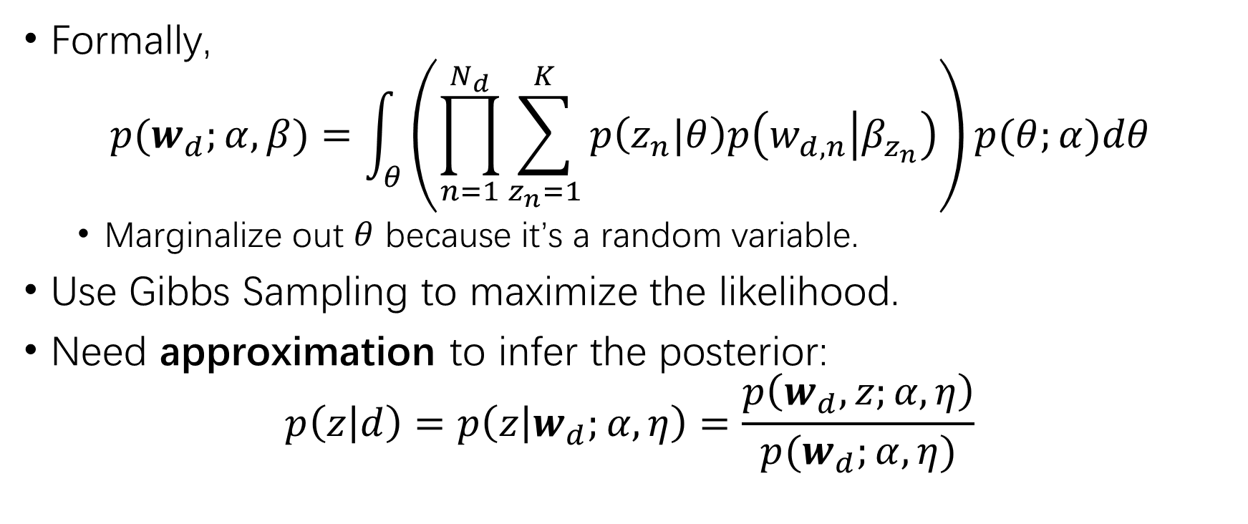
Latent Dirichlet Allocation
Formally,
$$p(w_{d};α,β)=\int_{θ}{\left(\prod_{n=1}^{N_{d}}{\sum_{z_{n}=1}^{K}{p\left(z_{n}|θ\right)p\left(w_{d,n} | β_{z_{n}}\right)}}\right)p(θ;α)dθ}$$
Marginalize out $θ$ because it’s a random variable.
Use Gibbs Sampling to maximize the likelihood.
Need approximation to infer the posterior:
$$p\left(z | d\right)=p\left(z | w_{d};α,η\right)=\frac{p\left(w_{d},z;α,η\right)}{p(w_{d};α,η)}$$

Slide 16
Neural Methods
Aims:
Solve the intractable posterior of LDA
Combine word embedding to Topic Modeling
Methods
Use neural networks as black box to infer the posterior
Inference network
GAN encoder
Involve word embedding in forming the latent topic distribution

Slide 17
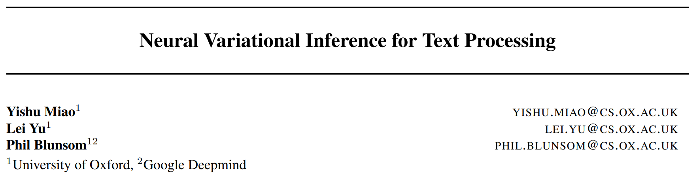
Variational Inference
ICML 2016

Slide 18
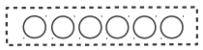
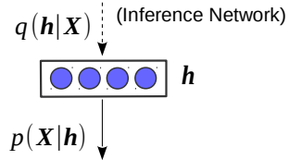

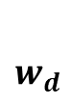
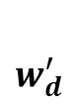
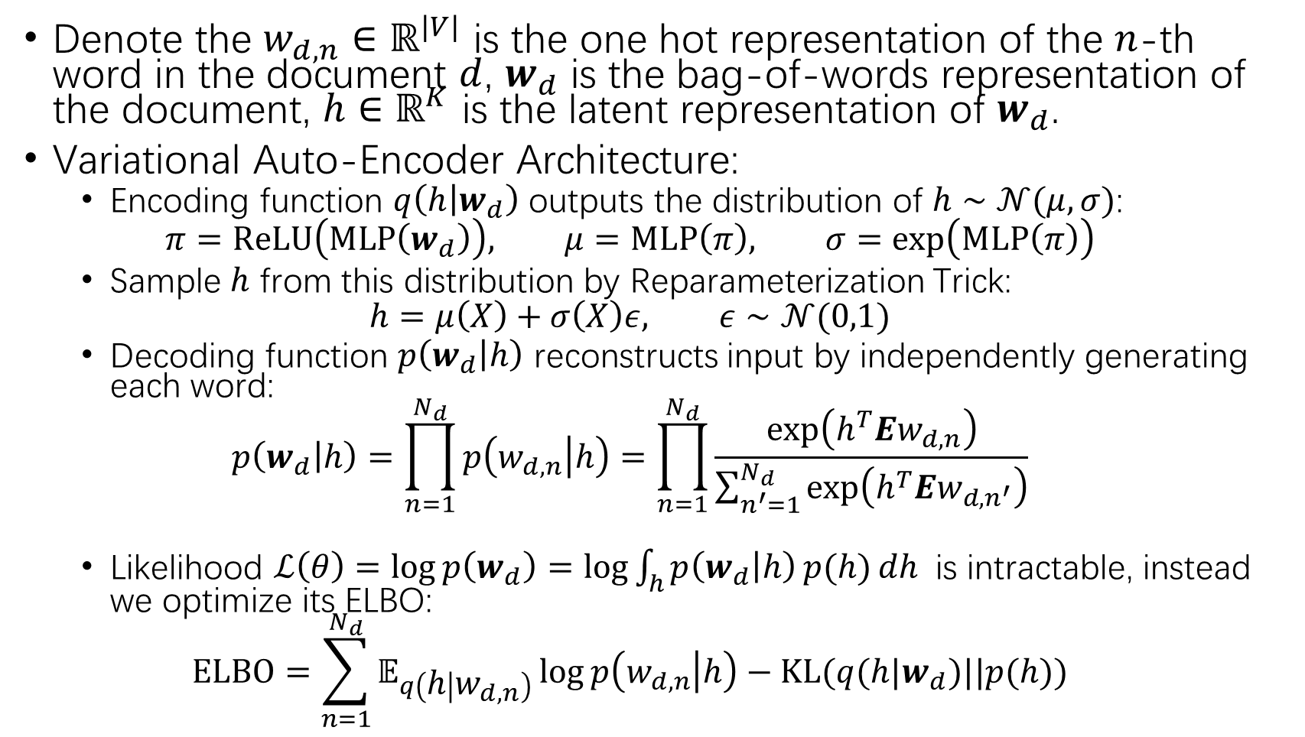
Denote the $w_{d,n}∈ℝ^{|V|}$ is the one hot representation of the $n$-th word in the document $d$, $w_{d}$ is the bag-of-words representation of the document, $h∈ℝ^{K}$ is the latent representation of $w_{d}$.
Variational Auto-Encoder Architecture:
Encoding function $q\left(h | w_{d}\right)$ outputs the distribution of $h∼𝒩(μ,σ)$:
$$π=ReLU\left(MLP\left(w_{d}\right)\right), μ=MLP\left(π\right), σ=\exp\left(MLP\left(π\right)\right)$$
Sample $h$ from this distribution by Reparameterization Trick:
$$h=μ\left(X\right)+σ\left(X\right)ε, ε∼𝒩(0,1)$$
Decoding function $p\left(w_{d} | h\right)$ reconstructs input by independently generating each word:
$$p\left(w_{d} | h\right)=\prod_{n=1}^{N_{d}}{p\left(w_{d,n} | h\right)}=\prod_{n=1}^{N_{d}}{\frac{\exp\left(h^{T}Ew_{d,n}\right)}{\sum_{n^{′}=1}^{N_{d}}{\exp\left(h^{T}Ew_{d,n^{′}}\right)}}}$$
Likelihood $ℒ\left(θ\right)=\log{p\left(w_{d}\right)=\log{\int_{h}{p\left(w_{d} | h\right)}p(h)}}dh$ is intractable, instead we optimize its ELBO:
$$ELBO=\sum_{n=1}^{N_{d}}{𝔼_{q\left(h | w_{d,n}\right)}\log{p\left(w_{d,n} | h\right)}}−KL(q(h|w_{d})||p(h))$$
$w_{d}$
$w_{d}^{′}$

Slide 19

ICLR 2017

Slide 20
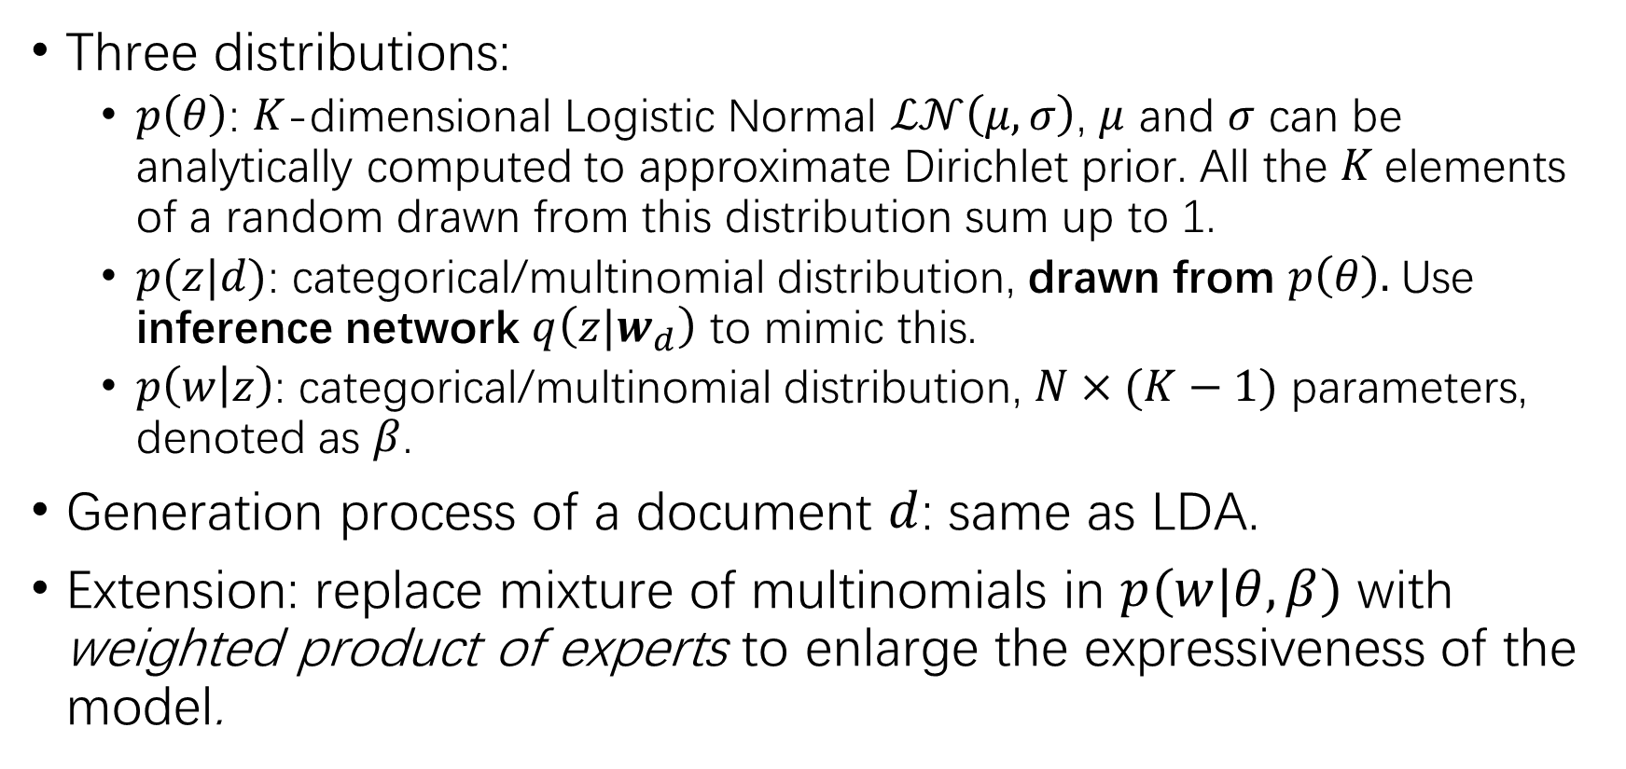
AutoEncoding Variational Inference for Topic Models
Three distributions:
$p\left(θ\right)$: $K$-dimensional Logistic Normal $ℒ𝒩\left(μ,σ\right)$, $μ$ and $σ$ can be analytically computed to approximate Dirichlet prior. All the $K$elements of a random drawn from this distribution sum up to 1.
$p(z|d)$: categorical/multinomial distribution, drawn from $p\left(θ\right).$Use inference network $q\left(z|w_{d}\right)$ to mimic this.
$p\left(w | z\right)$: categorical/multinomial distribution, $N×(K−1)$ parameters, denoted as $β$.
Generation process of a document $d$: same as LDA.
Extension: replace mixture of multinomials in $p(w|θ,β)$ with weighted product of experts to enlarge the expressiveness of the model.

Slide 21
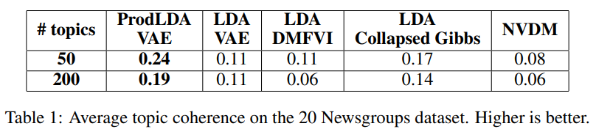
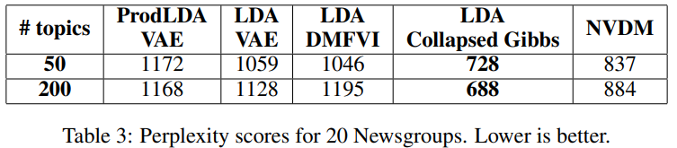
20NewsGroup
ProdLDA: product of experts;
LDAVAE: logistic normal as prior;
LDADMFVI: mean field inference LDA;
Topic Coherence: Normalized Pointwise Mutual Information

Slide 22
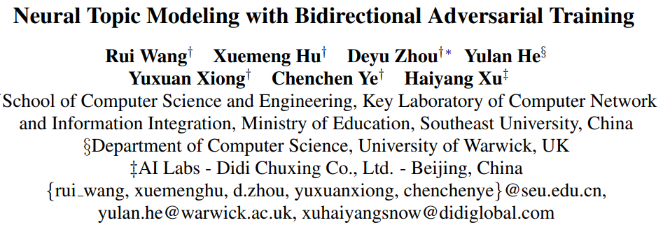
GAN
ACL 2020

Slide 23
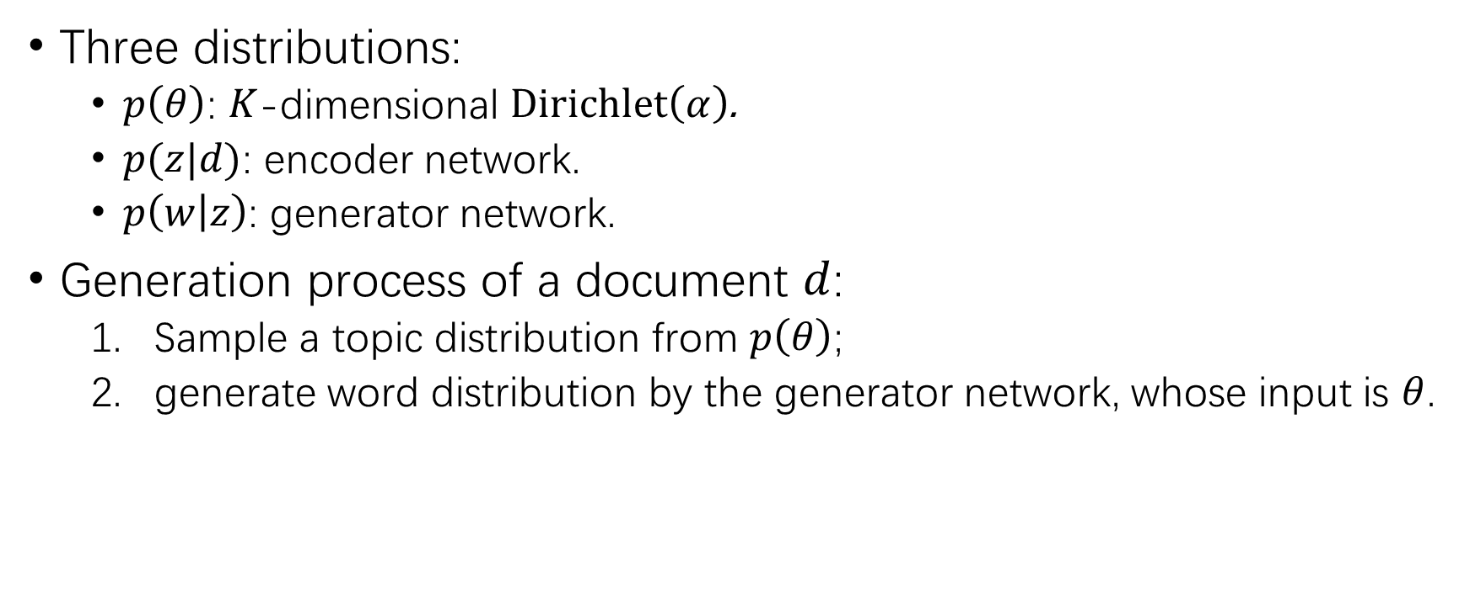
Neural Topic Modeling with Bidirectional Adverserial Training
Three distributions:
$p\left(θ\right)$: $K$-dimensional $Dirichlet\left(α\right)$.
$p(z|d)$: encoder network.
$p\left(w | z\right)$: generator network.
Generation process of a document $d$:
Sample a topic distribution from $p\left(θ\right)$;
generate word distribution by the generator network, whose input is $θ$.

Slide 24
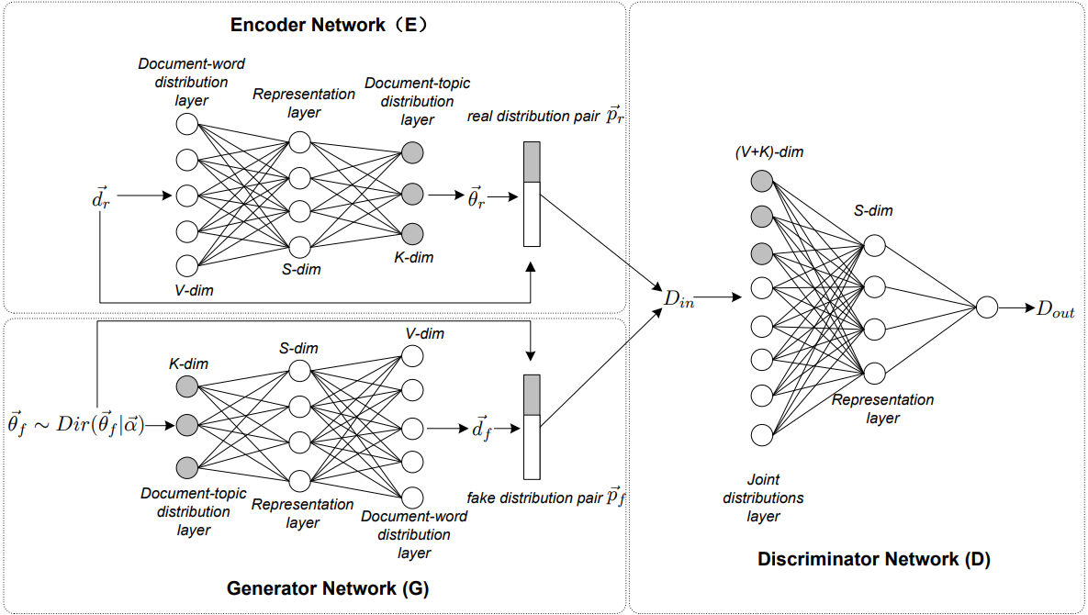
Neural Topic Modeling with Bidirectional Adverserial Training

Slide 25
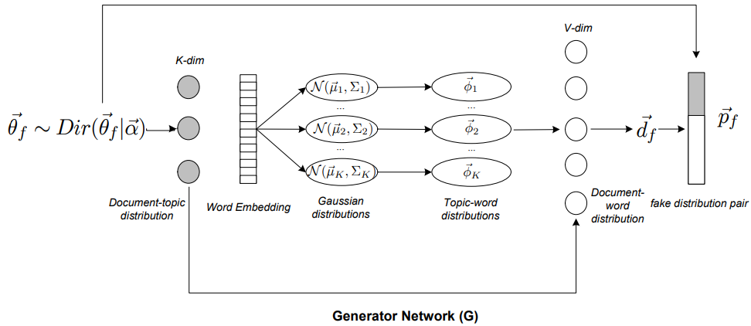
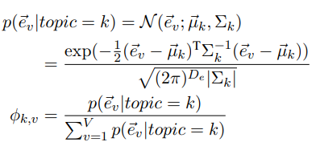
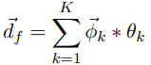
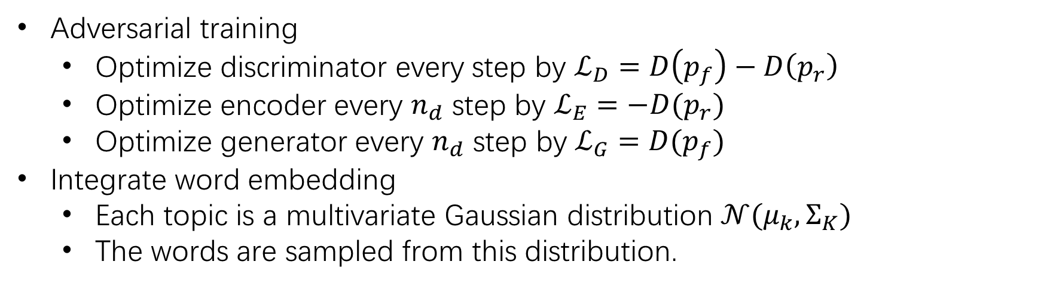
Neural Topic Modeling with Bidirectional Adverserial Training
Adversarial training
Optimize discriminator every step by $ℒ_{D}=D\left(p_{f}\right)−D\left(p_{r}\right)$
Optimize encoder every $n_{d}$ step by $ℒ_{E}=−D(p_{r})$
Optimize generator every $n_{d}$ step by $ℒ_{G}=D(p_{f})$
Integrate word embedding
Each topic is a multivariate Gaussian distribution $𝒩(μ_{k},Σ_{K})$
The words are sampled from this distribution.

Slide 26
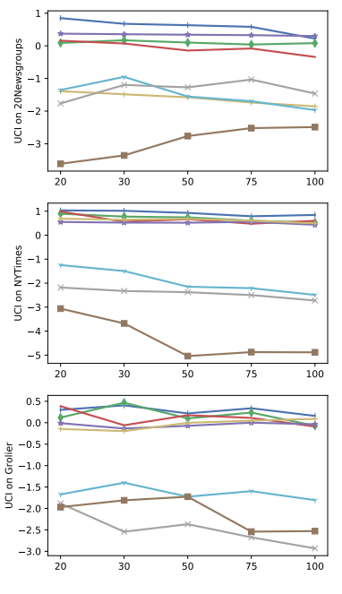
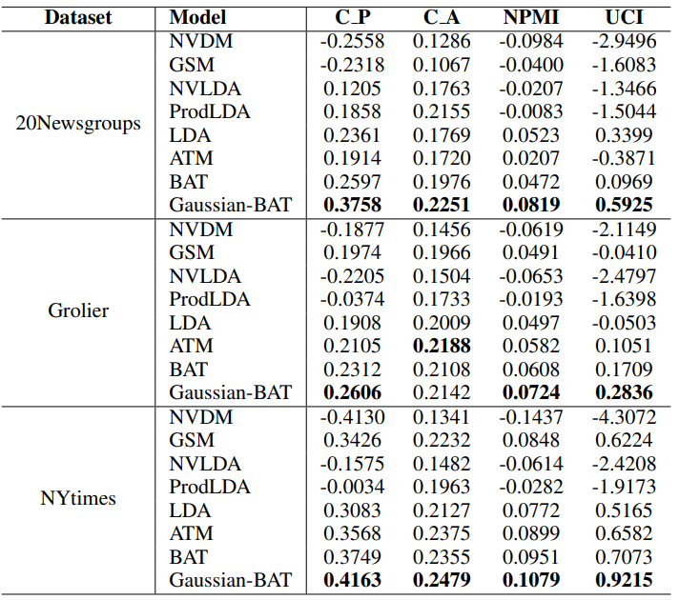

Slide 27
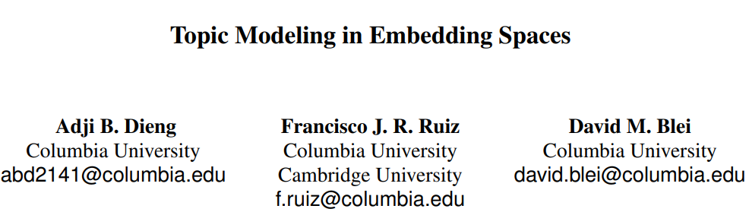
Combine word embedding
ACL 2020

Slide 28
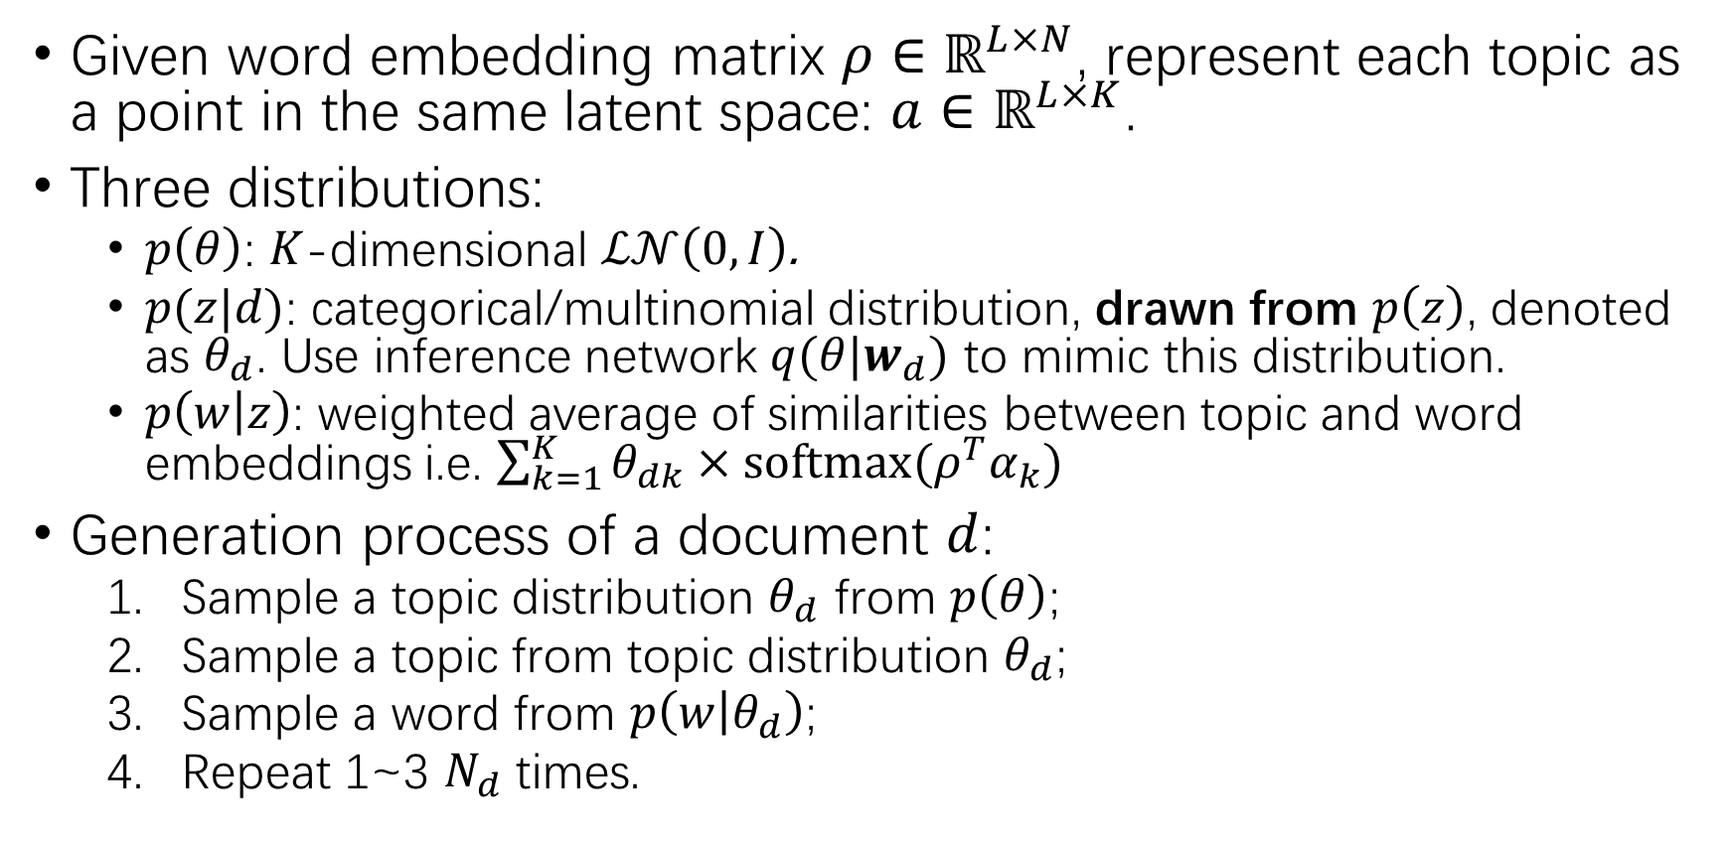
Topic Modeling in Embedding Space
Given word embedding matrix $ρ∈ℝ^{L×N}$, represent each topic as a point in the same latent space: $a∈ℝ^{L×K}$.
Three distributions:
$p\left(θ\right)$: $K$-dimensional $ℒ𝒩\left(0, I\right)$.
$p(z|d)$: categorical/multinomial distribution, drawn from $p\left(z\right)$, denoted as $θ_{d}$. Use inference network $q(θ|w_{d})$ to mimic this distribution.
$p\left(w | z\right)$: weighted average of similarities between topic and word embeddings i.e. $\sum_{k=1}^{K}{θ_{dk}×softmax(ρ^{T}α_{k})}$
Generation process of a document $d$:
Sample a topic distribution $θ_{d}$ from $p\left(θ\right)$;
Sample a topic from topic distribution $θ_{d}$;
Sample a word from $p\left(w | θ_{d}\right)$;
Repeat 1~3 $N_{d}$ times.

Slide 29
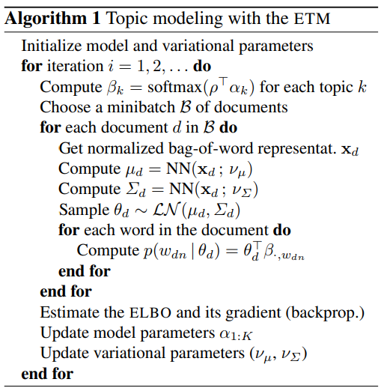
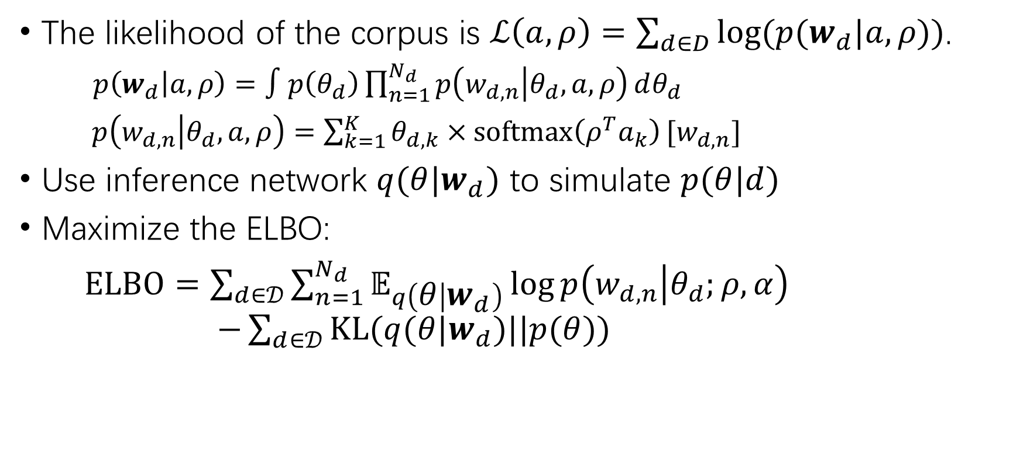
Topic Modeling in Embedding Space
The likelihood of the corpus is $ℒ\left(a,ρ\right)=\sum_{d∈D}{log⁡(p(w_{d}|a,ρ))}$.
$p\left(w_{d} | a,ρ\right)=∫p\left(θ_{d}\right)\prod_{n=1}^{N_{d}}{p\left(w_{d,n} | θ_{d},a,ρ\right)}dθ_{d}$
$p\left(w_{d,n} | θ_{d},a,ρ\right)=\sum_{k=1}^{K}{θ_{d,k}×softmax\left(ρ^{T}a_{k}\right)}[w_{d,n}]$
Use inference network $q(θ|w_{d})$ to simulate $p(θ|d)$
Maximize the ELBO:
$ELBO=\sum_{d∈𝒟}{\sum_{n=1}^{N_{d}}{𝔼_{q\left(θ | w_{d}\right)}\log{p\left(w_{d,n} | θ_{d};ρ,α\right)}}}$ $−\sum_{d∈𝒟}{KL(q(θ|w_{d})||p(θ))}$

Slide 30
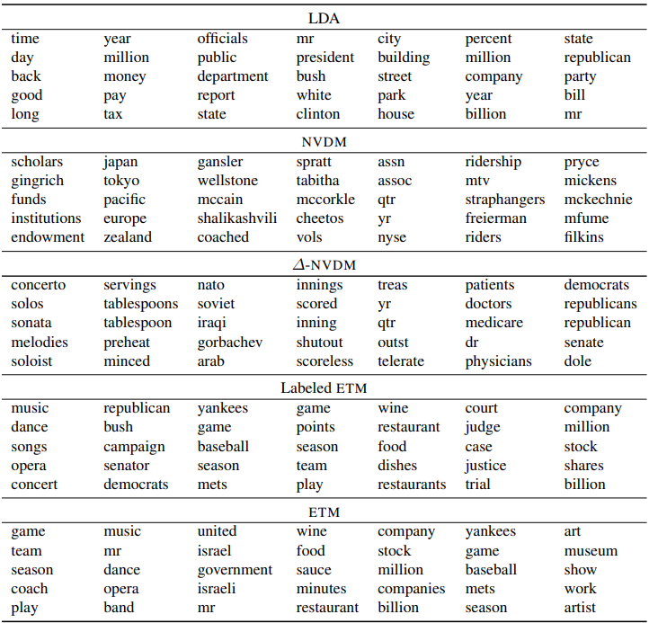

Slide 31
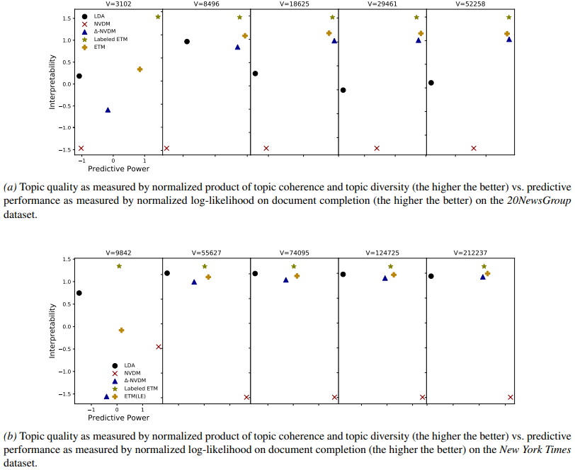
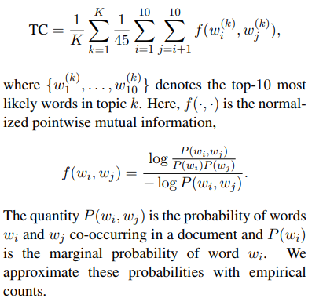
Topic Coherence
Prediction Power in a Document Completion Task
Divide each test document into two sets of words;
The first half is fed to the encoder for a topic proportion;
Use this topic proportion to generate the second set of words and compute likelihood.

Slide 32
BERT-based methods
Enjoy the merits of pretrained language models
Use contextualized embeddings to overcome bag-of-words.

Slide 33
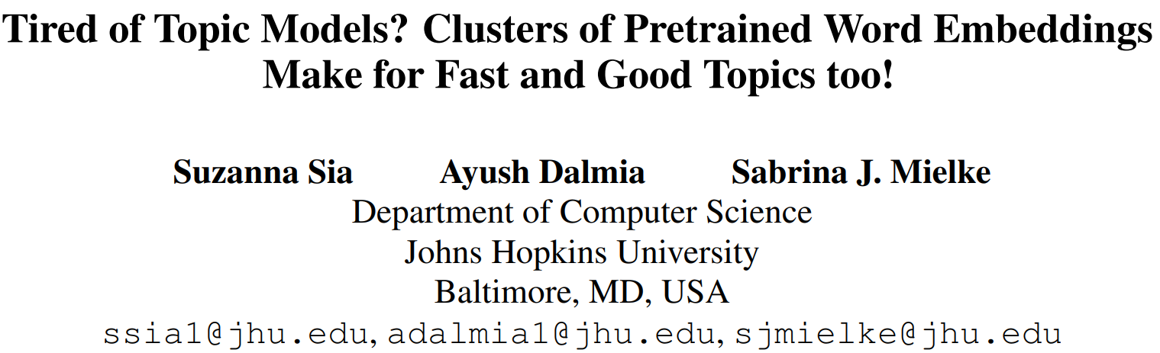
ACL 2020

Slide 34
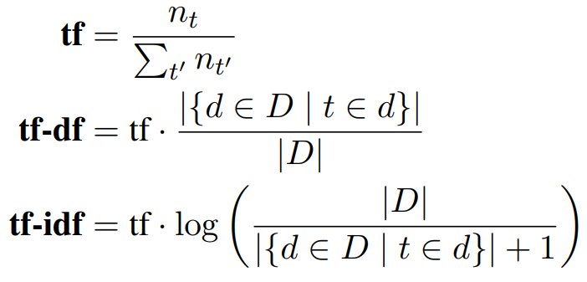
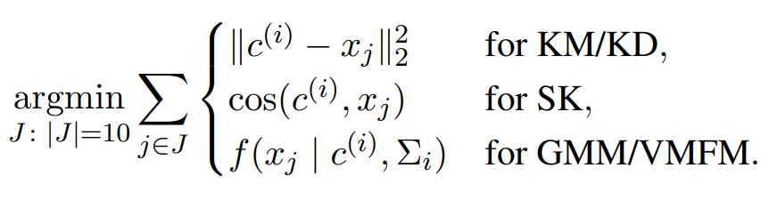
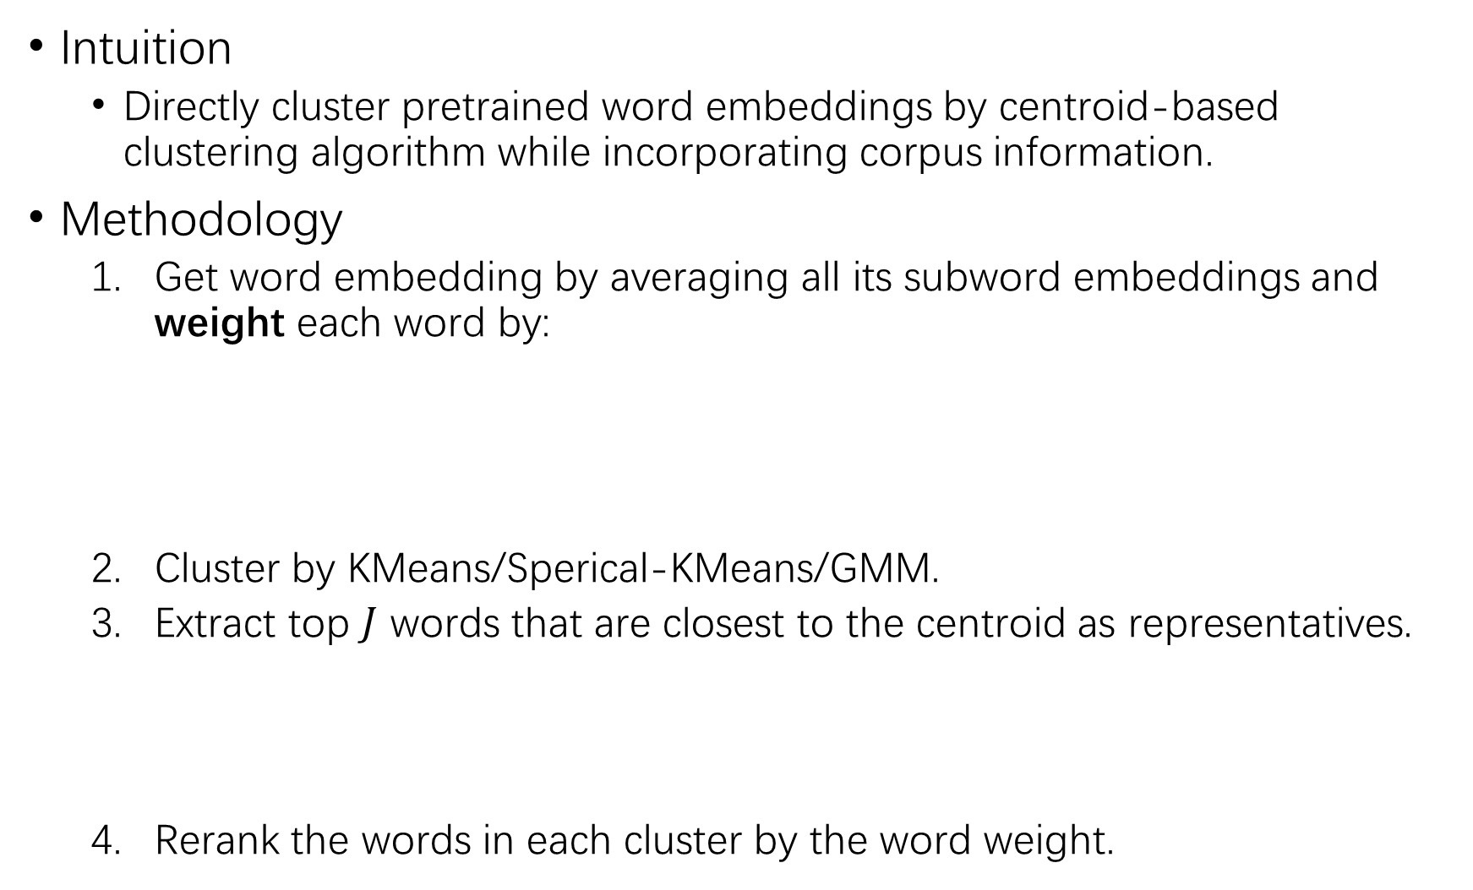
Intuition
Directly cluster pretrained word embeddings by centroid-based clustering algorithm while incorporating corpus information.
Methodology
Get word embedding by averaging all its subword embeddings and weight each word by:
Cluster by KMeans/Sperical-KMeans/GMM.
Extract top $J$ words that are closest to the centroid as representatives.
Rerank the words in each cluster by the word weight.

Slide 35
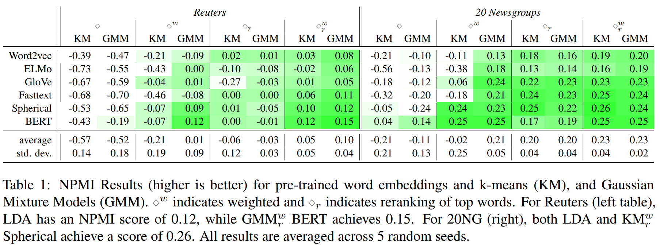
Experiments
20NewsGroup and Reuters Dataset
Split dataset into 60% training set and 40% test set. Training set is used to clustering and get top 10 words for each topic, while test set is used to evaluate the Normalized Pointwise Mutual Information as a measure of topic coherence.

Slide 36
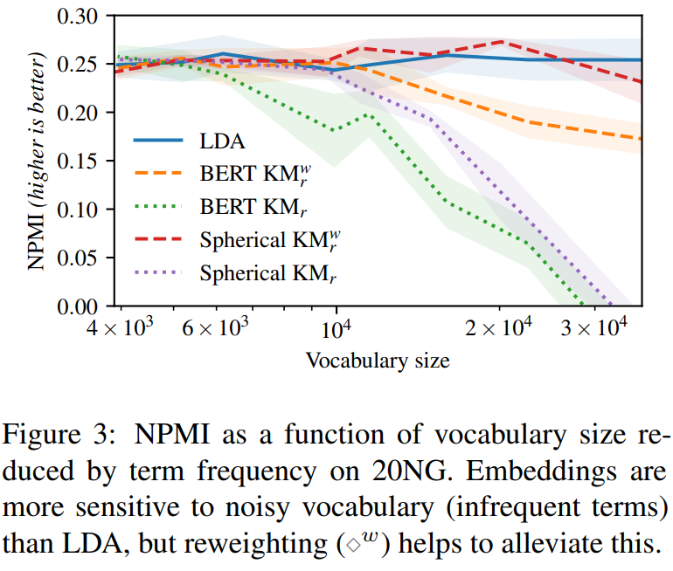
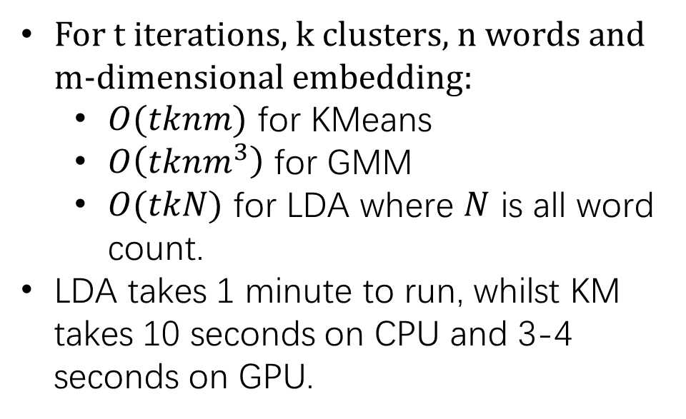
Influence of infrequent terms
Complexity
For t iterations, k clusters, n words and m-dimensional embedding:
$O(tknm)$ for KMeans
$O\left(tknm^{3}\right)$ for GMM
$O(tkN)$ for LDA where $N$ is all word count.
LDA takes 1 minute to run, whilst KM takes 10 seconds on CPU and 3-4 seconds on GPU.

Slide 37
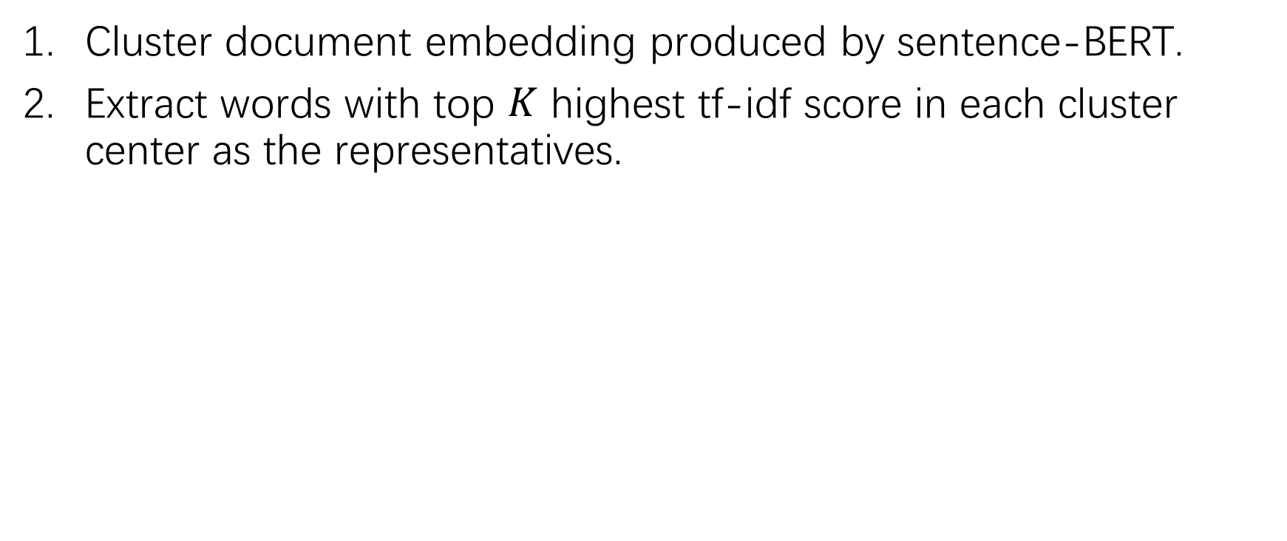
BERTopic
Cluster document embedding produced by sentence-BERT.
Extract words with top $K$ highest tf-idf score in each cluster center as the representatives.

Slide 38
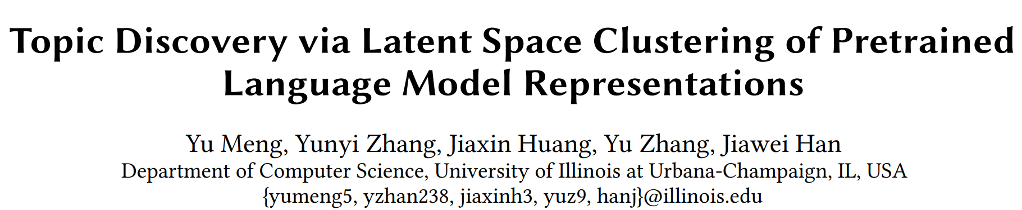
WWW 2022

Slide 39
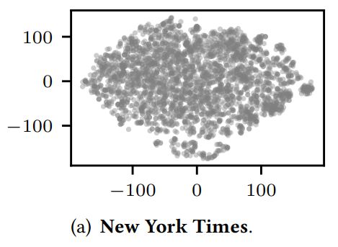

Challenges for PLM-based Topic Model
Unsuitability of PLM Embedding Space for Clustering
The embedding spaces of BERT do not exhibit clearly separated clusters and applying clustering algorithms like 𝐾-means to these spaces leads to low-quality and unstable clusters.
This is because Masked Language Modeling objective assumes the learned contextualized embeddings are generated from a Gaussian Mixture Model (GMM) with $|V|$ mixture components where $|V|$ is the vocabulary size of BERT.
Randomly sample 3000 word embeddings and visualize by t-SNE:

Slide 40
Challenges for PLM-based Topic Model
Curse of Dimensionality
The Euclidean distance is no longer reliable in a high-dimensional space, causing Euclidean distance based clustering algorithms ineffective.
Lack of Good Document Representations from BERT
BERT document embedding obtained from [CLS] is bad as stated in Sentence-BERT.
Using Sentence-BERT for topic modeling raises two issues:
When the corpus significantly diverges with the training set of Sentence-BERT, retraining is needed. However, training Sentence-BERT requires manual labels in Natural Language Inference task, which contradicts with the unsupervised nature of topic modeling.
The sentence embedding lies in a different latent space against word embeddings, thereby cannot be used to model document-topic distribution.

Slide 41

Methodology
Three distributions:
$p\left(θ\right)$: no prior knowledge.
$p(z|d)$: measured by similarity between document and topic vector in latent space.
$p\left(w | z\right)$: measured by similarity between word and topic vector in latent space.
Generation process of a document $d$:
Sample topic $t_{k}∼Uniform(K)$
Sample latent word representation $z_{i}^{(w)}∼vMF(t_{k},κ)$
Map the latent word back to the original word embedding space using a deep neural network: $h_{i}^{(w)}=DNN(z_{i}^{(w)})$

Slide 42

Methodology

Slide 43



Methodology
Learning Document Embedding
Attentively pool word embeddings into the document embedding. Keep the word embedding $h_{i}^{\left(w\right)}$ fixed.
Spherical Topic Space
Project the original embedding space $H∈ℝ^{r}$ to spherical latent space $Z∈ℝ^{r^{′}},∀z∈Z, \left|\left|z\right|\right|=1$ by a MLP.
The variables in $Z$ follow $K$ mixture of $r^{′}$-variate von Mises-Fisher distribution, where the topic vector $t$ is mean of one component, $γ$ is hyper parameter.
$$p\left(z;t,γ\right)=n_{r^{′}}\left(γ\right)\exp\left(γ⋅\cos\left(z,t\right)\right)$$

Slide 44




Training
Cluster in Spherical Space: Jointly learn the topic latent space and the assignment of topics.
$p(t_{k}|z_{i}^{(w)})$ is the topic assignment for each word;
$q(t_{k}|z_{i}^{(w)})$ is the target topic assignment for each word, just like the average of cluster nodes in KMeans.
Move $p$ towards $q$ by minimizing cross-entropy:
$q$ encourages distinctive topic assignment ($p^{2}$) and balanced clustering ($s_{k}$). [ICML 2016: Unsupervised Deep Embedding for Clustering Analysis]

Slide 45




Training
Reconstruct document by aggregating its topics
Ensure the learned latent topics are meaningful summaries of the documents.
Preserve PLM embeddings
Ensure the latent space preserves the important semantic information of the original embedding space

Slide 46

Training

Slide 47
Experiments
Datasets
NYT; Yelp.
Metrics
Topic Coherence
Umass, UCI
Intrusion: Given the top words in a topic, we randomly inject one word from another topic then employ a human evaluator to identify this outlier. The precision is used.
Topic Diversity
The percentage of unique words in one topic.
Document Clustering Task
Normalized Mutual Information between clusters

Slide 48


Experiments

Slide 49

Experiments

Slide 50

Summary
Lacks unified metrics/tasks to evaluate the model.
The dataset is small.
Neural methods is generally better than traditional methods when incorporating word embeddings.
Methodology
How to jointly project contextualized word embeddings and document embeddings
How to design proper $p(θ)$, $p(w|z)$ and $p(z|d)$ in the latent space
How to overcome bag-of-words

